Slide 1
Machine Learning Clustering

Slide 2
Table of Contents
Unsupervised Learning
Clustering
Types of Clustering
K-Means
K-Means ++
Bisecting K-Means
K-Means: Strength & Weakness
Choosing K
Cluster Evaluation: Silhouette Score
Hierarchical Clustering

Slide 3
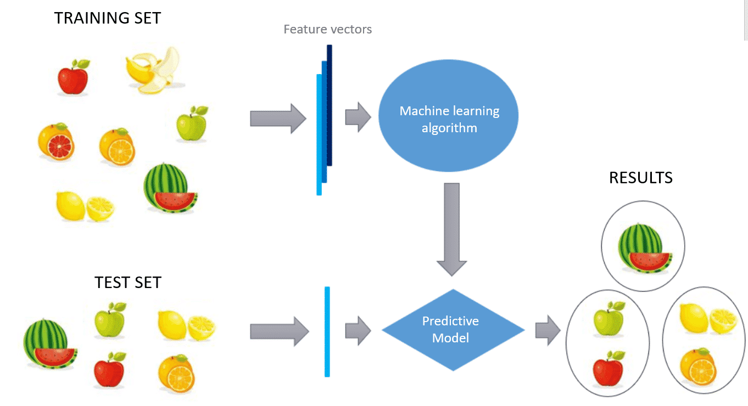
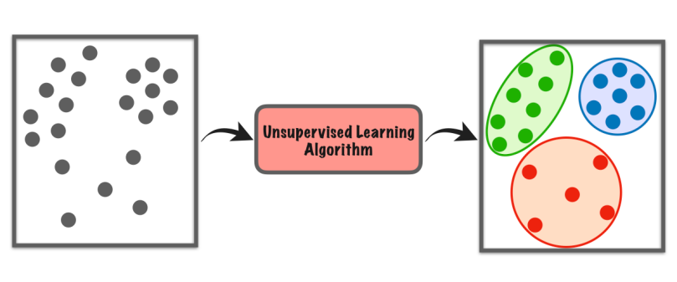
Unsupervised Learning
No Labels
Model looks for patterns in a dataset without any labels and with minimal supervision.
Unsupervised algorithms use unlabeled data to find the underlying structure of the dataset, group data according to similarities and represent the dataset in a compressed format.
Common Tasks: Clustering, Dimensionality Reduction, Association Mining etc.

Slide 4
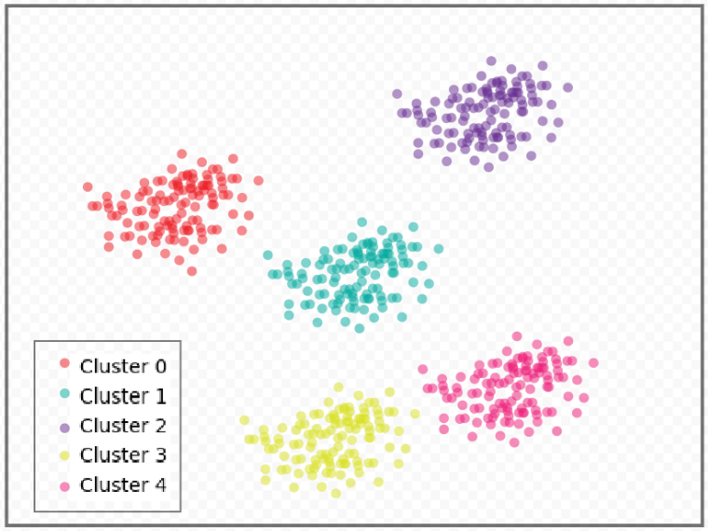
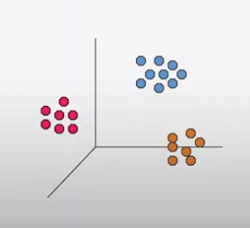
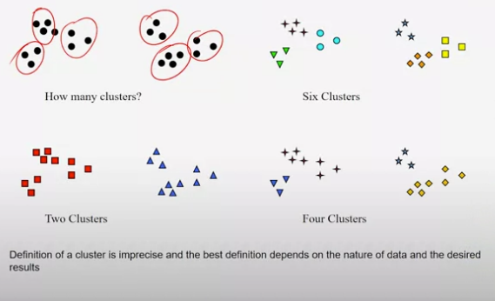
Clustering
Task of dividing the entire data into groups or clusters based on the patterns in the data.
Finding groups of objects such that the objects in a group will be similar (Homogeneous) to one another and different from (Heterogeneous) the objects in other groups.
Intra-cluster distances are minimized & Inter-cluster distances are maximized
More possibility of error rate.
Clustering can help in identifying outliers or anomalies of data
Clustering can also be used for feature engineering in supervised learning
Notion of cluster can be ambiguous

Slide 5
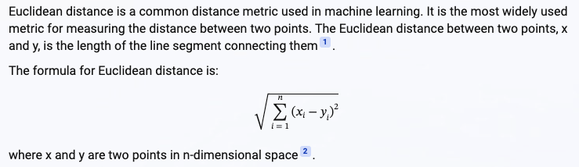
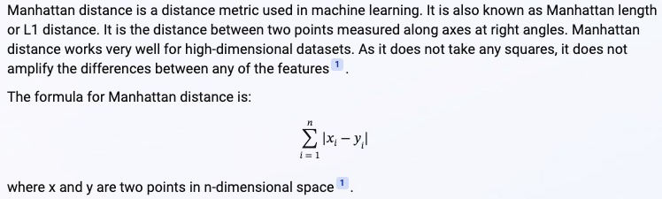
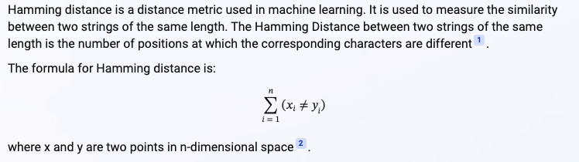
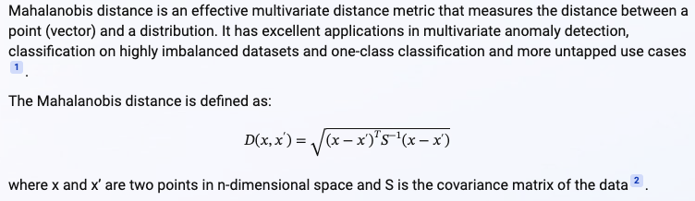
Types of Clustering
Hard Clustering: Each datapoints belongs to a cluster exclusively. E.g., K-Means
Soft Clustering: Same datapoint can be present in multiple clusters but associated with a probability. Sum of the probabilities equals 1. E.g., Latent Dirichlet Allocation
Types of Clustering Methods
1. Centroid Based / Partitioning
- Group data points based on the distance of data points towards each centroids. E.g., K-Means
- Proximity between data points to the centroid is measured by
Euclidean Distance
Manhattan distance
Hamming distance
Mahalanobis distance etc

Slide 6
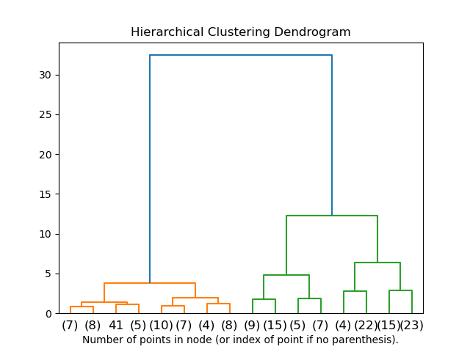
Types of Clustering
2. Connectivity-based
Data points closer in data space exhibit more similarity to each other that the data points lying farther away
Approach 1: Start by classifying all data points into separate clusters & then aggregating them as the distance decreases.
Approach 2: all data points are classified as a single cluster and then partitioned as the distance increases
These models are very easy to interpret but lack scalability for handling big datasets
Hierarchical Clustering
The linkage criterion calculates the proximity between clusters,
Single linkage: Distance between closest points of clusters; minimum distance between clusters. Good for detecting arbitrarily shaped clusters but cannot detect overlapping clusters. It is efficient to compute but is not robust to noisy data
Complete / Maximum linkage: Distance between furthest points of clusters; maximum distance between clusters. Good for detecting overlapping clusters but cannot detect arbitrarily shaped clusters
Average linkage: Average of all distances across two clusters
Centroid linkage: Distance between centers of two clusters
Ward linkage: Sum of squared distance from each data point to the centroid of the cluster they are assigned to. This results in cluster merging that gives the smallest increase in total variance within all clusters. Ward linkage is the default linkage criterion

Slide 7
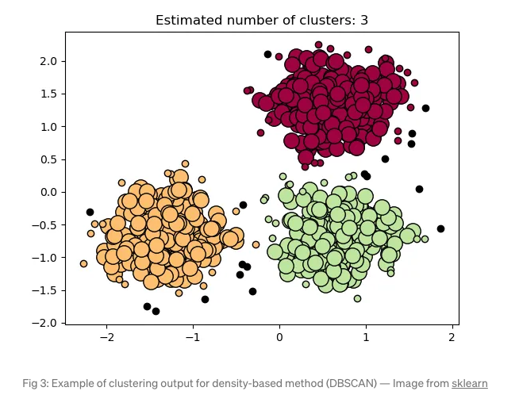
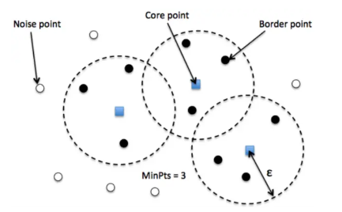
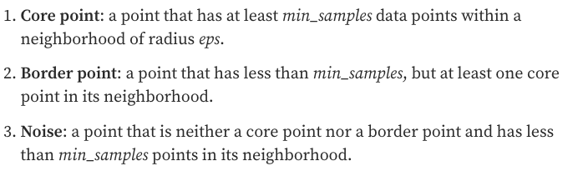
Types of Clustering
3. Density-based
Group data points based on density instead of distance
Search the data space for areas of the varied density of data points in the data space
Isolate different dense regions and assign the data points within these regions to the same cluster.
Particularly useful for identifying clusters of arbitrary shape and detecting outliers
Density-Based Spatial Clustering of Application with Noise (DBSCAN)
DBSCAN algorithm clusters data points that are in dense regions together, separated by areas of low density. Samples in denser areas within eps units apart with more than min_samples number of data points are called core samples.
When to use DBSCAN
Unsure about the number of clusters: DBSCAN does not require the number of clusters to be predefined.
Can be arbitrarily-shaped clusters: Clusters are determined by dense regions, hence cluster shapes can be odd-shaped or complex.
Detect outliers: Data points that are not assigned to any cluster as they do not fall in any dense region will be considered outliers.
DBSCAN output is highly influenced and sensitive to the eps parameter, which must be chosen appropriately for the data set.
DBSCAN Clustering: Visual Guide

Slide 8
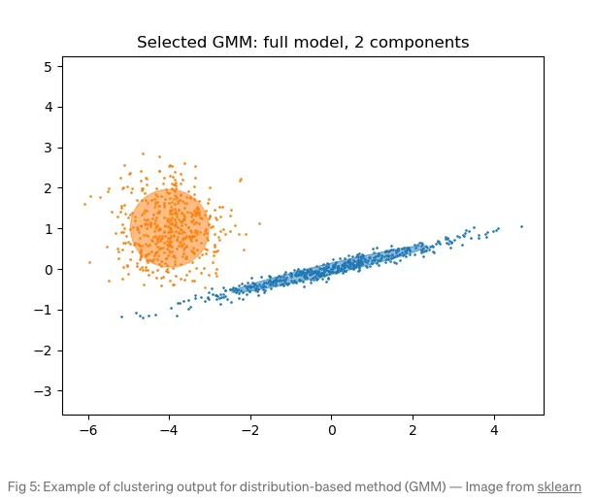
Types of Clustering
3. Distribution-based
Likelihood of data points belong to same probability distribution
Distribution-based methods use statistical inference to cluster data such that the closer the data point is to a central point, the higher the probability to be assigned to that cluster
Compared to clustering methods that consider distance measures, distribution-based methods are more flexible in determining the shape of clusters
If clusters are noisy, the results will overfit
Gaussian Mixture Model GMM assumes that every data point is generated from multiple Gaussian distributions with unknown parameters and performs iterative Expectation Maximization (EM) steps to fit the data points.
In the Expectation (E) step, data points are assigned to clusters that assume randomly selected Gaussian parameters. In the Maximization (M) step, the parameters of the Gaussian distribution are updated to best fit the data points in the cluster.
When to use GMM
Computation efficiency: GMM is the fastest distribution-based algorithm
Clusters follow a Gaussian distribution: Distribution can be tweaked to fit spherical, diagonal, tied, or full covariance matrices
Insufficient data in each cluster: It is hard to compute the covariance matrices when there are insufficient data points in a Gaussian distribution

Slide 9
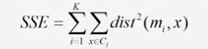
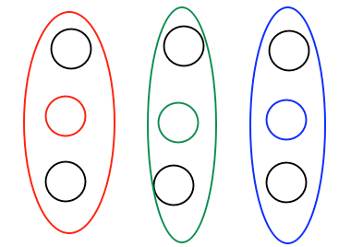
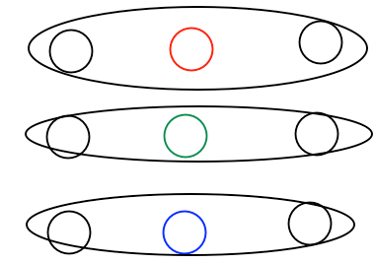
K-Means Clustering
Partitional Clustering
Each cluster is associated with a centroid
Each point is assigned to the cluster with the closest centroid
Number of clusters, K, must be specified
Evaluating K-Means Clusters
Most common measure is Sum of Squared Error (SSE)
For each point, the error is the distance to the nearest cluster
To get SSE, we square these errors and sum them
X is a data point in the cluster Ci and mi is the representative point for cluster Ci
Given two clusters, we can choose the one with smallest error
K – means algorithm is guaranteed to find a clustering that represents a local minimum with respect to the SSE
What happens if K = 1?
What happens if K = N ?
Algorithm
Select K points as the initial centroids
Repeat
Form K clusters by assigning all points to the closest centroid
Recompute the centroid for each clusters
Until the centroids don’t change
Use similarity to the centroid to determine the membership. E.g., Euclidean distance, cosine similarity etc.
Algorithm will converge when the cluster centers no longer change, but
results may not be optimal

Slide 10
K-Means ++
K-Means
Handle initial centroid problems
Sensitive to initialization – Multiple runs with different initial centers
Choosing the point furthest from the previous centers – might be sensitive to outliers
Sample and use Hierarchical clustering to determine initial centroids
K Clusters are extracted from the hierarchical clustering and the centroids of these clusters are used as initial centroids
Works well but is practical only if the sample is relatively small and K is relatively small compared to the sample size
Select more that k initial centroids and then select among these initial centroids
Select most widely separated
Updates centers incrementally
K-Means++:
New Centers are chosen with probabilities (as a function of distance to closest prior centers)
Kind of between “random” and “furthest point” techniques

Slide 11
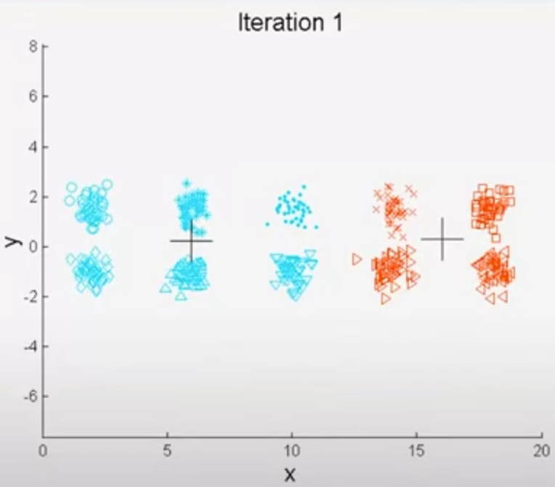
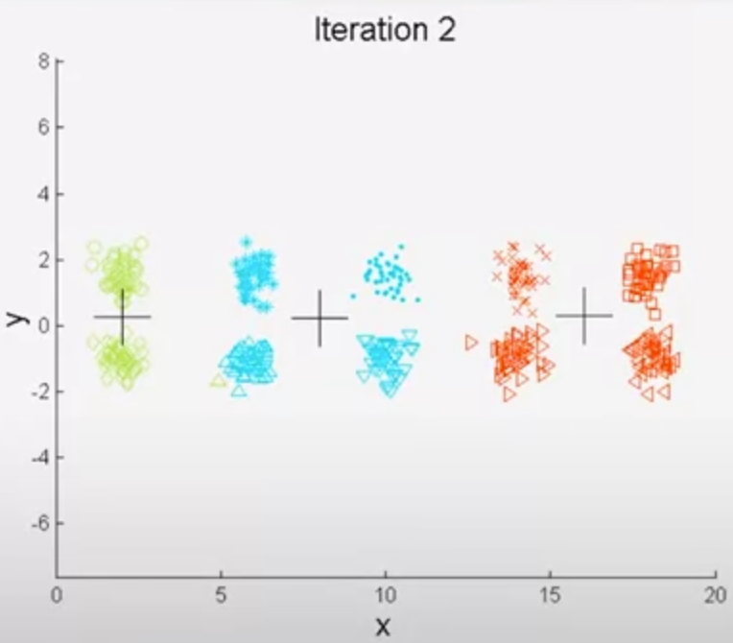

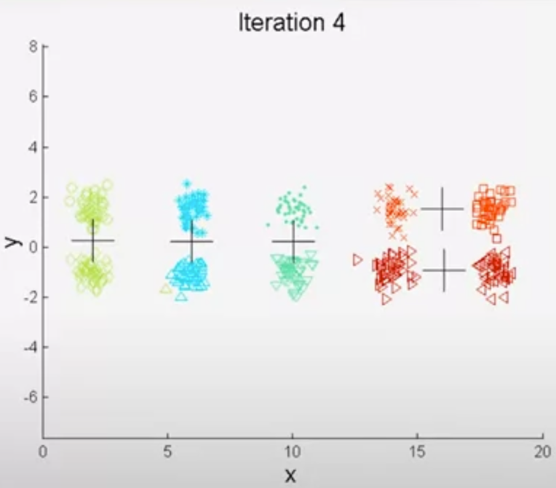
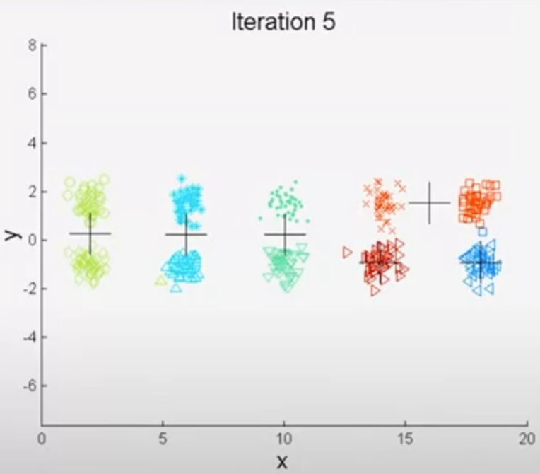
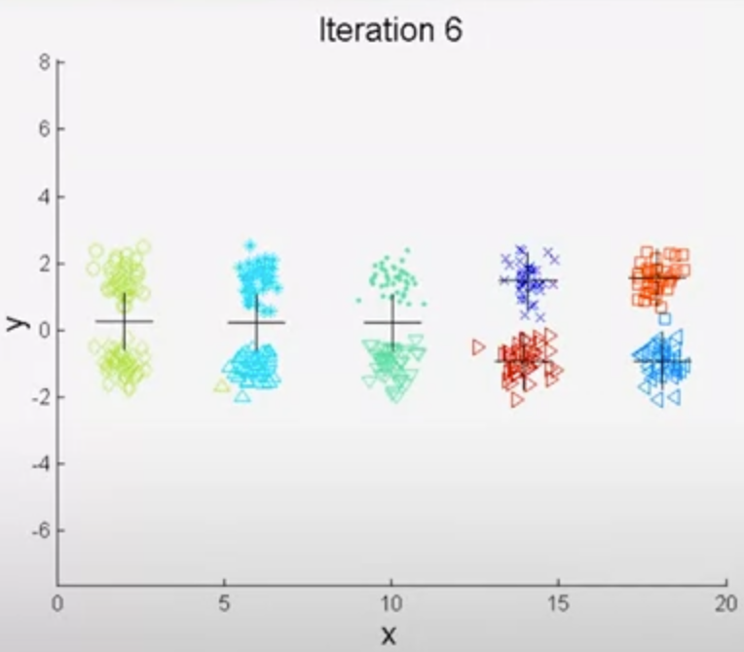
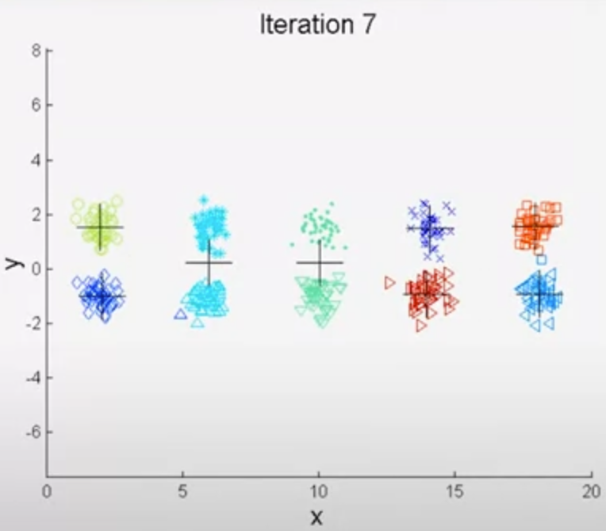
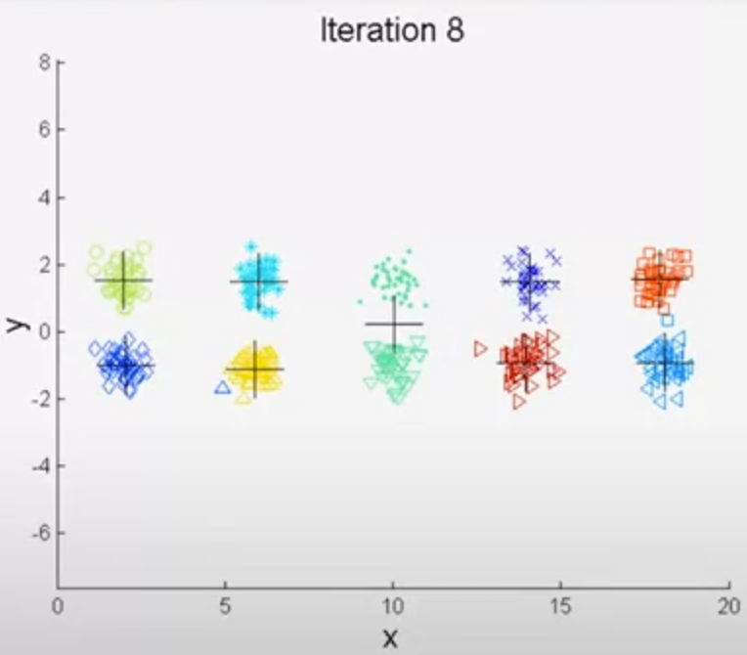
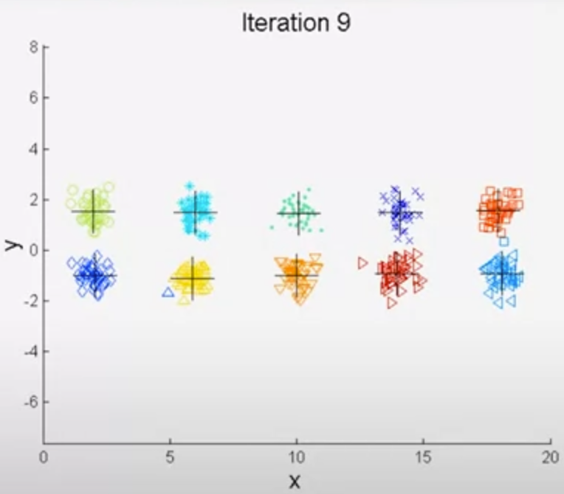
Bisecting K-Means
Straightforward extension if the basic K-Means algorithm
It is based on the following simple idea:
To obtain K clusters, split the set of all points into two clusters
Select one of these clusters to split
Continue the process until K clusters have been produced
There are many ways to choose which cluster to split:
Choose the largest cluster at each step
Choose the cluster producing the largest SSE
Derive a criterion based on both size and SSE
Different choices result in different clusters
Bisecting K-means has less trouble with initialization because it performs several trial bisections and takes the one with lowest SSE and there are only two centroids at each stage

Slide 12
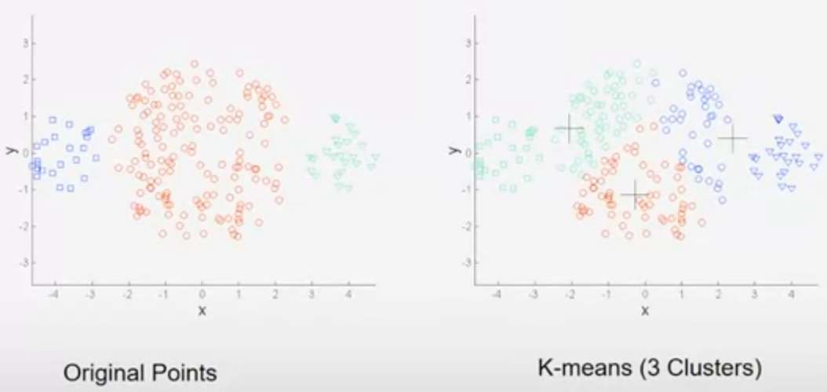
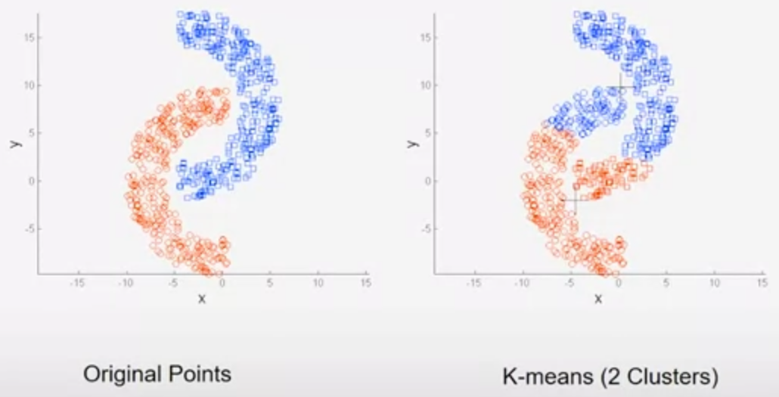
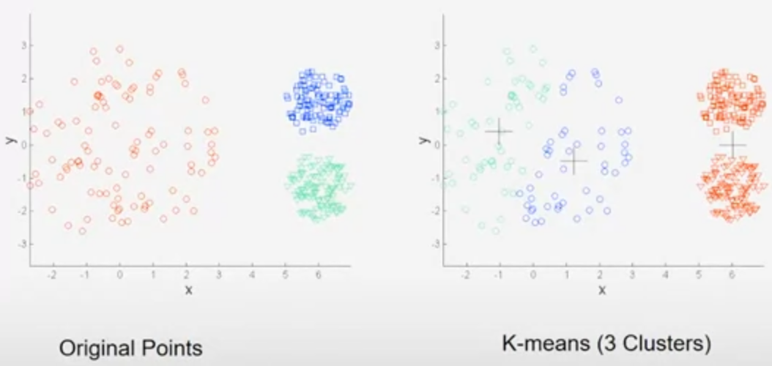
K-Means: Strength & Weakness
Strength
Simple and efficient
Variants like bisecting K-means are less susceptible to initialization problems
Weaknesses
Cannot handle non-globular clusters or clusters of different sizes and densities
Has trouble clustering data that has outliers
Clusters with different size
Clusters with non-globular shape
Clusters with different densities

Slide 13
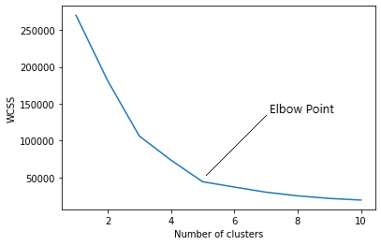
Choosing ‘K’
Elbow Method
Vary the number of K
Calculate WCSS (within cluster sum of squares) → Sum of squared distance between each point and the centroid in a cluster.
WCSS decreases as the number of cluster increases.
Graph will rapidly change at a point and creates an Elbow shape (from here, graph will be mostly parallel to X- axis.
The K value corresponding to this point will help to narrow down the optimal K range (ex: 4 or 5 or 6 etc..)
Analyze cluster further to finalize the K
WCSS does not capture inter-cluster distance
How to further analyze whether cluster is good or not?

Slide 14
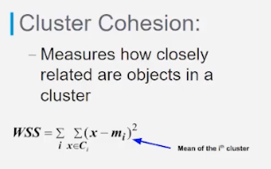
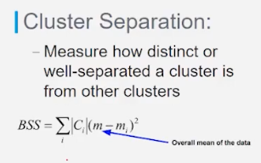
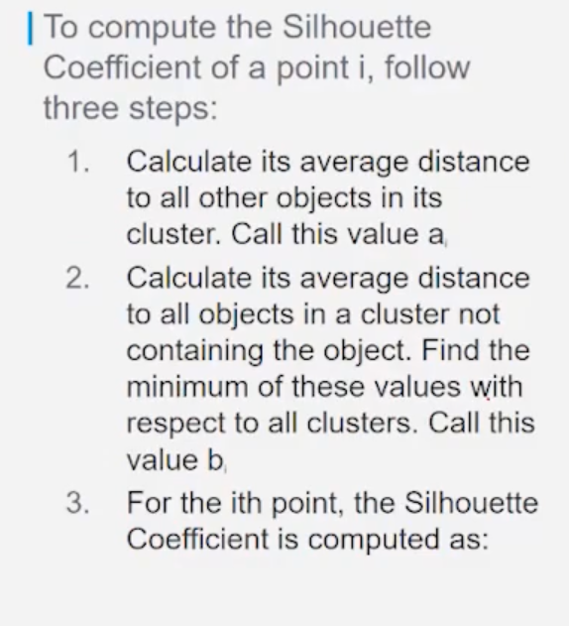
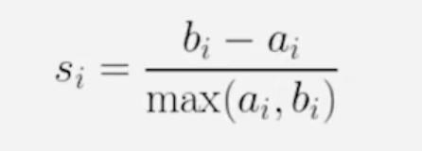
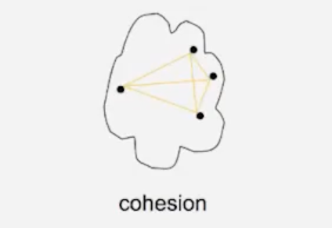
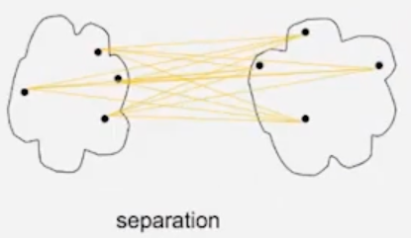
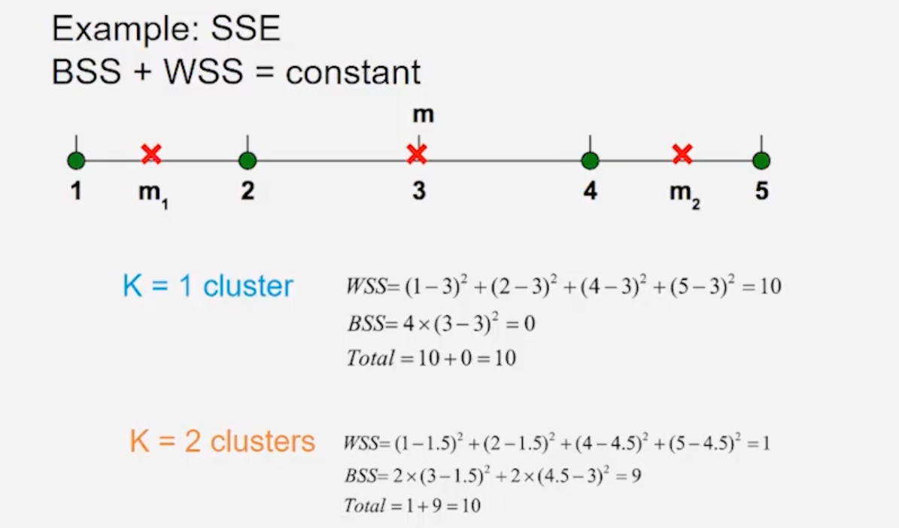
Silhouette Score
Cluster Cohesion & Cluster Separation
Silhouette score is a metric used to evaluate the performance of clustering algorithms. It measures how well data points are clustered with other similar data points and how far they are from different clusters.
Ranges from -1 to 1 (higher score means better cluster quality)
ai measures the intra-cluster distance
bi measures the minimum inter-cluster distance
sklearn.metrics.silhouette_score(X, labels, ..)
Compute the mean silhouette Coefficient of all samples

Slide 15
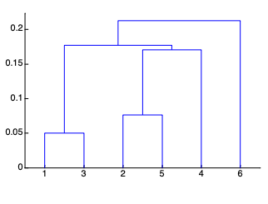
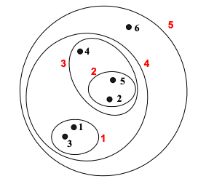
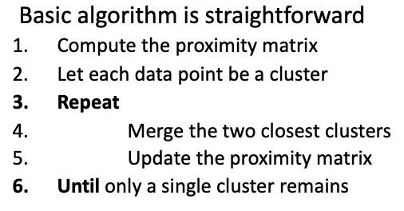
Hierarchical Clustering
Hierarchical clustering techniques are a second important category of clustering methods
There are two basic approaches for generating a hierarchical clustering:
Agglomerative: Start with the points as individual clusters and at each step, merge the closest pair of clusters. This requires defining a notion of cluster proximity
Divisive: Start with one, all inclusive cluster and at each step, split a cluster until only singleton clusters of individual points remain. In this case, we need to decide which clusters to split at each stage and how to do the splitting.
Agglomerative clustering is by far the most common and we will focus on these methods
A hierarchical clustering is often displayed graphically using a tree-like diagram called the dendrogram, which displays both the cluster-subcluster relationships and the order in which the clusters were merged (agglomerative) or split (divisive)
Do not have to assume any particular number of clusters
Any desired number of clusters can be obtained by ‘cutting’ the dendrogram at the proper level
Can use it with smaller sample to determine K and use other algorithms to model the data

Slide 16
Clustering as Features

